Slide 1
Soft Skills:
Building a Culture
Mike Kennamer
Alabama Community College Association
Annual Conference
Birmingham, Alabama
November 24, 2014

Slide 2
Outline
Importance of Soft Skills
Teaching Soft Skills
Measuring Soft Skills
Rewarding Exemplary Soft Skills
Best Practices Discussion

Slide 3

What work skills are needed?

Slide 4
What work skills are needed?
Domain Expertise
Authority in a particular area or topic
Subject matter expert

Slide 5
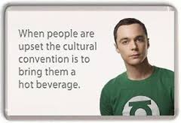
What work skills are needed?
Soft Skills
Personal qualities, habits, attitudes and social graces that make someone a good employee.
Being part of a team

Slide 6
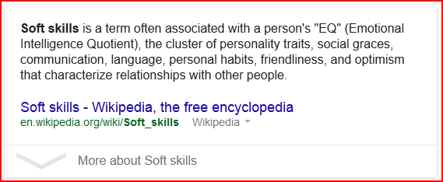
Definition

Slide 7
What are the most important work skills?

Slide 8
In what proportion do we need these skills?

Slide 9
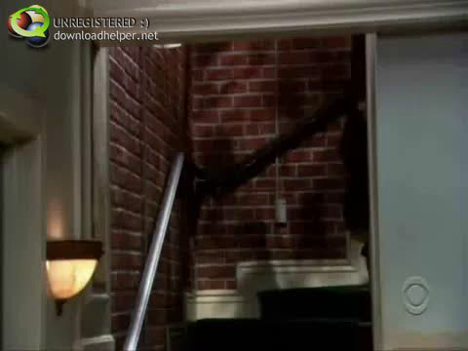

Slide 10

Traditional Model
Academic skills
Application of academic skills
Technical skills

Slide 11
We never taught soft skills in the past. Why is this an issue today?

Slide 12
Sofa Culture
Few real responsibilities
Chores optional
Farm Culture
Hard-working
Chores part of everyday life

Slide 13
1900 1950 2000

Slide 14
Job Market in 1950
Source: U.S. Department of Labor

Slide 15
Job Market in 1950
40% of jobs required domain expertise.
60% required nothing but work ethic.
Source: U.S. Department of Labor

Slide 16
Job Market in 2010
Source: U.S. Department of Labor

Slide 17
Job Market in 2010
85% of jobs required domain expertise.
15% required nothing but work ethic.
Source: U.S. Department of Labor

Slide 18
2013 Alabama HS Graduates
44,751 high school graduates
22,872 enrolled in public colleges
21,879 did not enroll/not reported/private
11,749 enrolled in public 2-year colleges
11,123 enrolled in public 4-year colleges
Source: ACHE

Slide 19
Long Term Success Depends on:

Slide 20
What percent of people are fired because of:
Inadequate domain knowledge – 20%
Inadequate soft skills – 80%

Slide 21
How much do we expend on each?
Time
Money
Effort

Slide 22

A Perfect Storm
High emphasis in domain expertise.
Lack of work ethic taught at home.
Expanded commuting areas.
Leads to…
High technical skill
Low soft skill

Slide 23
Soft Skills Gap
“The soft skills piece is something we’ve been hearing from business and industry a good bit.”
“…understanding you need to show up on time, knowing how to dress, knowing how to work in teams, knowing how to get along with others—those kinds of basic skills.”
Dr. Mark Heinrich, Chancellor
Alabama Community College System

Slide 24
Soft Skills Gap
“used as the top one or two criteria in deciding promotions.”
“If there is a glass ceiling holding people back, this is it.”
Michael Stutzman
Rockwell Collins

Slide 25
Soft Skills Gap
“Each company looks for a different mix of skills and experience depending on the business it’s in. Yet it’s no longer enough to be a functional expert. To complement these unique core competencies, there are certain soft skills every company looks for in a potential hire.”
Kate Lorenz
AOL

Slide 26
You probably have a soft skills gap if…
You are really good at getting clients, and not so good at retaining them.
You have lots of staff turnover .
Mindtools

Slide 27
Teaching Soft Skills
Can soft skills be taught?

Slide 28
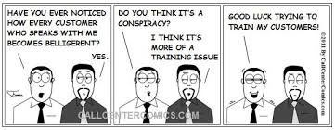
Teaching Soft Skills

Slide 29
Teaching Soft Skills
Model appropriate behavior.
Teachable moments.
Give students realistic expectations.
Be consistent.
Make soft skills an integral part of the curriculum, and the culture.

Slide 30
Examples of Teaching Soft Skills
Clean work area before leaving each day.
Expect students to arrive on time and leave only after class is dismissed.

Slide 31
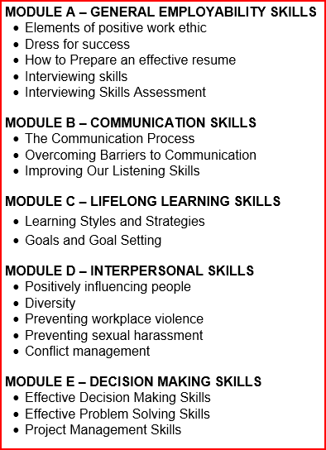
WKO 106 – Workplace Skills

Slide 32
NACC Requirements
All CER and AAS students (with exception of RN and PN) are required to take WKO 106 in their next to last term.
Includes WorkKeys, Career Readiness Certificate, and OSHA 10 Hour Course

Slide 33
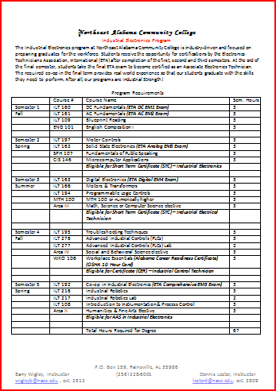
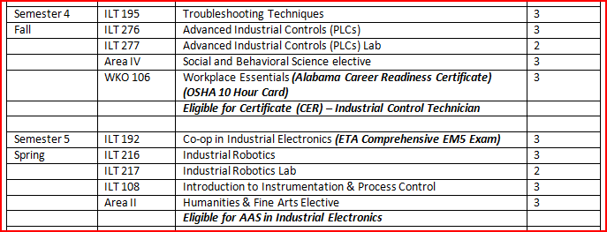
Career Pathways Guide

Slide 34
Measuring Soft Skills
How are soft skills measured or assessed?
What sets apart an exemplary student?

Slide 35
Workplace Readiness Certification (WRC)
Sets expectations
Rewards exemplary soft skills
Provides industry-recognized certification

Slide 36
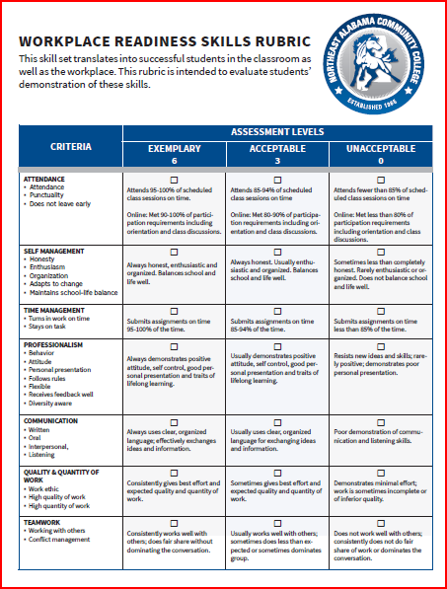

Slide 37


Slide 38
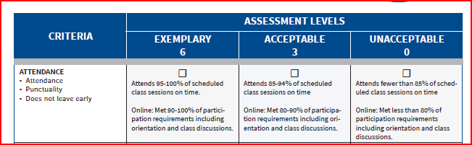

Slide 39



Slide 41
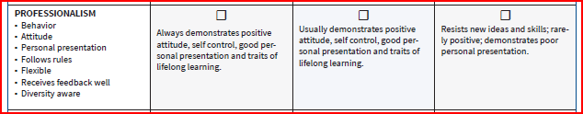

Slide 42


Slide 43


Slide 44


Slide 46
WRC Requirements
Minimum of 36 points on a soft skills evaluation AND a grade of A or B in at least six classes.
Instructor signs off on Passport (No instructor may sign more than twice)
Submit Passport to Office of Workforce Development where a WRC will be awarded.

Slide 47
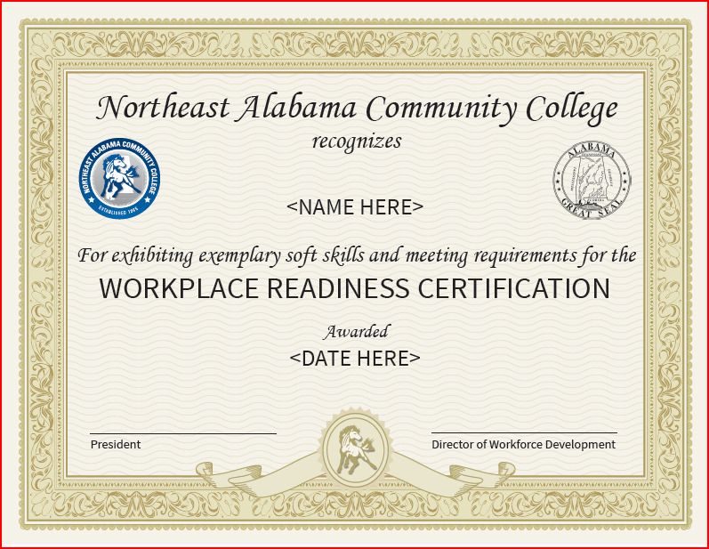
WRC front

Slide 48
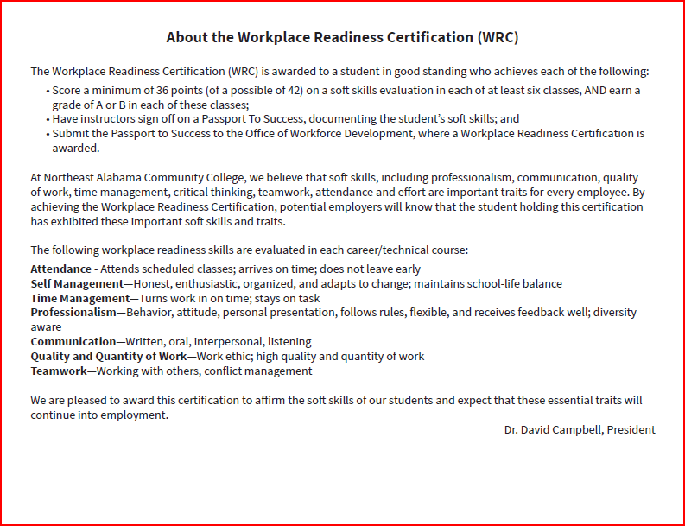
WRC back

Slide 49
Keys to Success

Slide 50
Keys to Success
Integrate soft skills into the culture of the college.

Slide 51
Keys to Success
Integrate soft skills into the culture of the college.
Seek the support and recognition of local business and industry.

Slide 52
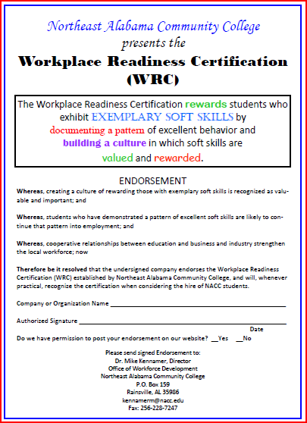

Slide 53
Keys to Success
Integrate soft skills into the culture of the college.
Seek the support and recognition of local business and industry.
Uphold standards.

Slide 54
Keys to Success
Integrate soft skills into the culture of the college.
Seek the support and recognition of local business and industry.
Uphold standards.
Students hear about soft skills in every class.

Slide 55
Building a Culture…Next Steps
Provide learning objects for instructors to use.
Continue to provide professional development opportunities for instructors.

Slide 56

Resources

Slide 57

Questions…
Mike Kennamer
kennamerm@nacc.edu

