Slide 1
Campus Security Authority
Mark Bailey
Jefferson State Community College

Slide 2
The Purpose
The purpose of the Clery Act is to provide the campus community with timely, accurate and complete information about criminal activity that could impact the health and safety of the campus community.

Slide 3
CSA Training
“While the Clery Act does not specifically require institutions to provide CSA training, it is virtually impossible to achieve compliance without it. (PSU FPRD P118)

Slide 4
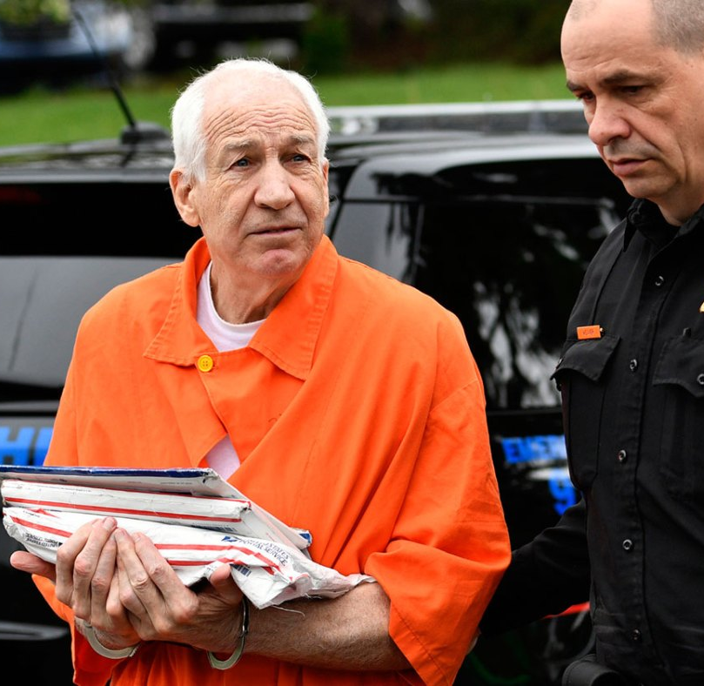
What brought us here
Jerry Sandusky
Served as assistant football coach under Joe Paterno at Penn State from 1969-1999
Convicted of 45 counts of sexual abuse on June 22, 2012

Slide 5
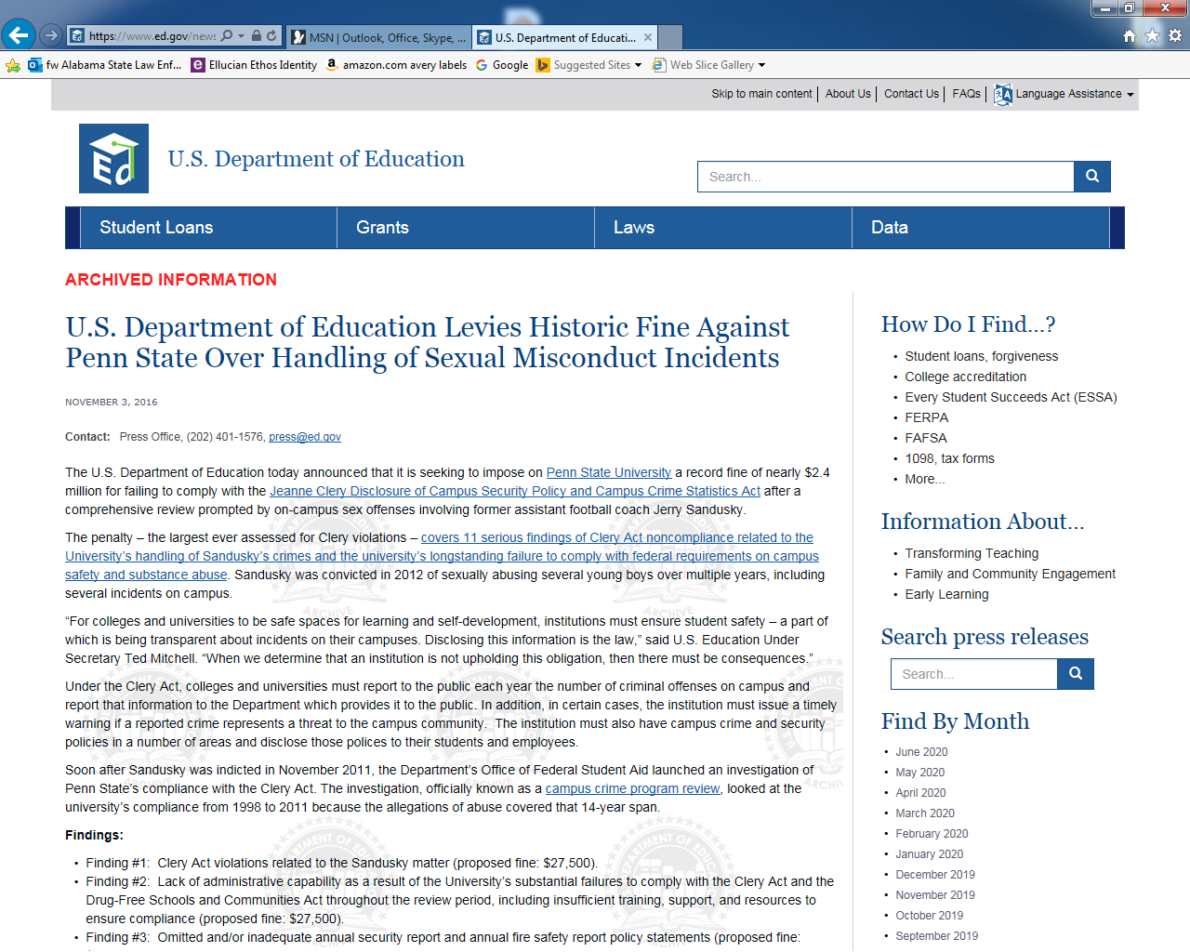

Slide 6
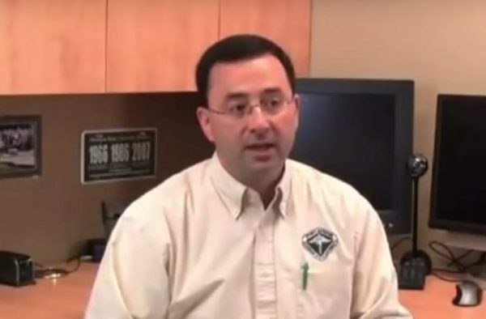
Larry Nasser
Michigan State, Director of Sports, osteopathic physician and former USA Gymnastics national team doctor
Plead guilty to seven counts of sexual assault of minors
Plead guilty to federal child pornography charges
Confessed to ten sexual assaults

Slide 8
MSU Noncompliance Findings
“Mighigan State substantially failed to actively seek out, identify and notify institutional officials who are ore were CSAs”
“This serious, systematic, and persistent condition contributed significantly to Michigan State’s ongoing failure to disclose accurate and complete crime statistics in its ASR’s throughout the review period, and as far back as 1997” (Michigan State University Campus Crime Program Review Report, 2018, p.22)

Slide 9
Campus Security Authority
Not all victims of crime want to report offenses to campus police. In order to collect as many crime reports as possible, other school employees are considered Campus Security Authorities.

Slide 10
Types of CSA’s
All Police Department Employees
Sworn
Non-Sworn
Includes contract Law Enforcement
All Security Department employees
Employed by the college
Contracted by the college

Slide 11
Types of CSA’s
Anyone with significant responsibility for student or campus activities and has the authority and duty to take action and respond to particular issues on behalf of the institution.
Deans
Department Chairs
Administrators that oversees separate campuses
Title IX Coordinators
Faculty or staff advisors to student organizations

Slide 12
Types of CSA’s
Members of conduct or hearing boards
Human Resources
ADA
Members of Behavioral Intervention Teams
ALL COACHES and SPORTS OFFICIALS
Student Group Advisors

Slide 13
Types of CSA’s
Anyone that you list in the ASR as a Security Authority

Slide 14
CSA RESPONSIBILITIES
When a person reports a crime to a Campus Security Authority and does not want to discuss the matter with Campus Police or local law law enforcement, the CSA has a responsibility to:
Notify Campus Police or other designated officials for timely warning notifications
Notify Campus Police / Security for inclusion on Daily Crime Report
Notify Campus Police or other designated officials for inclusion in statistics in Annual Crime Report

Slide 15
Confidential Report Situations
Victim notifies CSA or
Victim notifies Campus Police of offense and does not want a report
This includes reports made by third parties

Slide 16
Who are not CSA’s
A faculty member who does not have any responsibility for students and campus activity beyond the classroom
Clerical staff
Housekeeping
Maintenance
Cafeteria staff
The Handbook for Campus Safety and Security Reporting Chapter 4-4

Slide 17
CSA’s are not responsible for . . .
Investigating the crime that was reported to them
Reporting information about a crime they overheard in a conversation between students.
Reporting information about a crime that was mentioned during an in-class discussion.
Reporting information about a crime that was mentioned during a speech, forum or group presentation.
Reporting information that the CSA receives in an indirect manner.
The Handbook for Campus Safety and Security Reporting Chapter 4-5

Slide 18
Where Did The Alleged Crime Occur?
On Campus Property
On Campus Student Housing Facilities
Noncampus Property
Public Property
The Handbook for Campus Safety and Security Reporting Chapter 2

Slide 19
Clery Crimes
Murder
Manslaughter
Sexual Assault
Rape
Fondling
Incest
Statutory Rape
Aggravated Assault
Robbery
Burglary
Motor Vehicle Theft
Arson
The Handbook for Campus Safety and Security Reporting Chapter 3

Slide 20
VAWA Offenses
Domestic Violence (any misdemeanor or felony act of violence)
Dating Violence (any misdemeanor or felony act of violence)
Stalking
The Handbook for Campus Safety and Security Reporting Chapter 3

Slide 21
Violence Against Women Act
Consent
No Means NO
Drugs / Alcohol

Slide 22
Sexual Assault
Evidence
Do not shower, wash or change
Do not shower, wash or change your clothes.
Do not brush
Do not brush your teeth.
Preserve
Preserve any evidence such as clothing, used condoms, towels, tissue or other items which may be useful for investigation purposes.

Slide 23
Hate Crimes
Criminal offense in which the victim was selected because of bias
Race
Religion
Sexual Orientation
Gender Identity
Ethnicity
National Origin
Disability
The Handbook for Campus Safety and Security Reporting Chapter 3

Slide 24
Hate Crimes
Larceny – Theft
Simple Assault
Intimidation
Vandalism
Aggravated Assault
Robbery
Burglary
Motor Vehicle Theft
Arson
Murder
Manslaughter
Sexual Assault
Rape
Fondling
Incest
Statutory Rape
The Handbook for Campus Safety and Security Reporting Chapter 3

Slide 25
Timely Warnings
One of the most important issues to stress to CSA’s is the timeliness of passing on the information to the person responsible for issuing timely warnings.
Timely warnings are required campus wide warning that alert the campus community to potential threats.
Timely warning do not identify victims.

Slide 26
Daily Crime Logs
Provide information to the campus community about criminal activity on campus
Does not identify victims or offenders
Just tell what happen, where and when
Includes information from CSA’s

